Slide 1
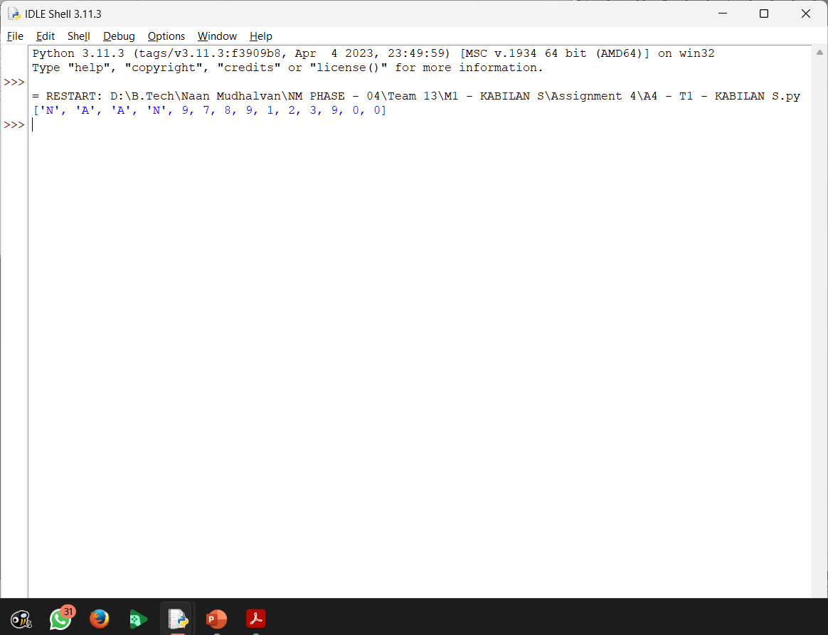
NAME | MOHAMED FOWAZ M.A
REG NO | 311520104032
CLASS | NM2023TMID07573
EMAIL ID | fawazcse17@gmail.com
 | ASSIGNMENT - 4
Task - 1 | Create two list and join those two list.
Coding:
list1 = ["N", "A" , "A" , "N"] list2 = [9, 7, 8, 9, 1, 2, 3, 9, 0, 0] list1.extend(list2) print(list1)
Output:

Slide 2
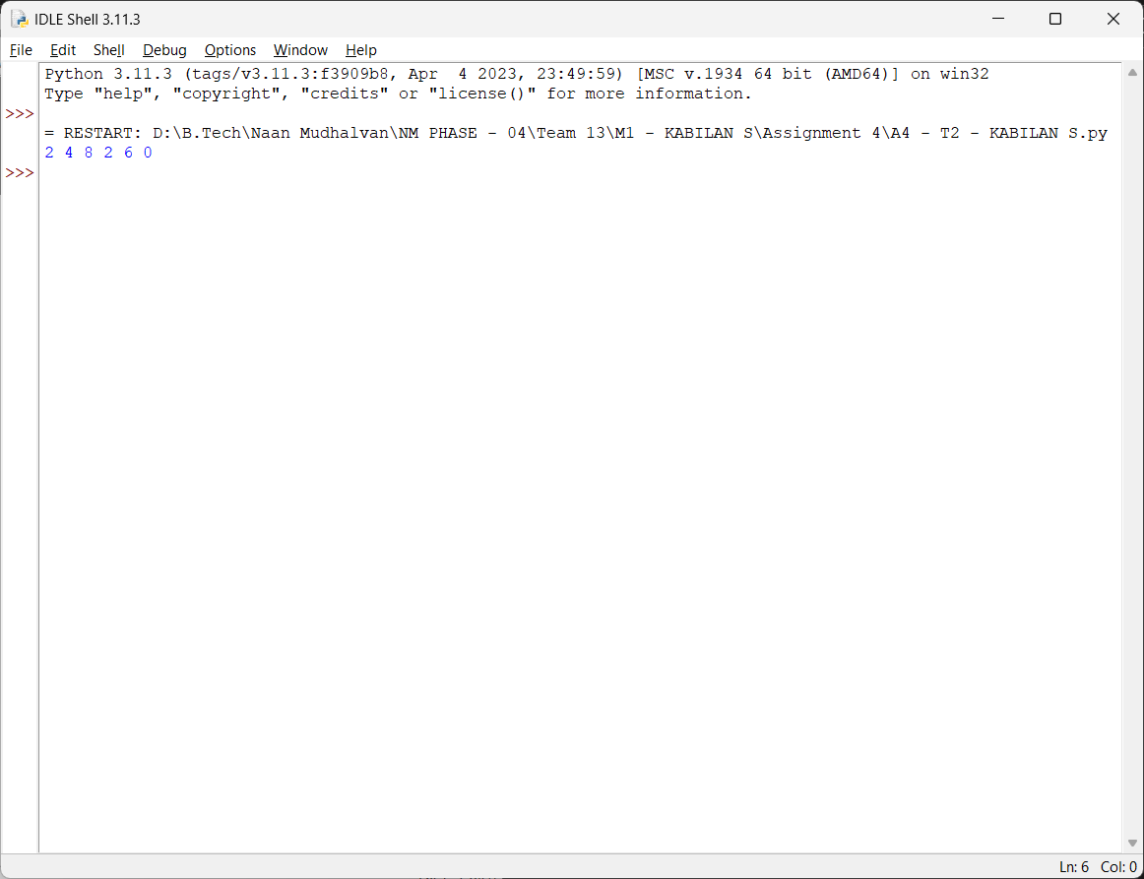
Task - 2 | With if statement find the even numbers.
Coding:
list1 = [1, 2, 3, 4] list2 = [9, 7, 8, 9, 1, 2, 3, 9, 6, 0] list3=list1.extend(list2) for n in list1: if (n%2==0): print(n, end=" ")
Output:

Slide 3
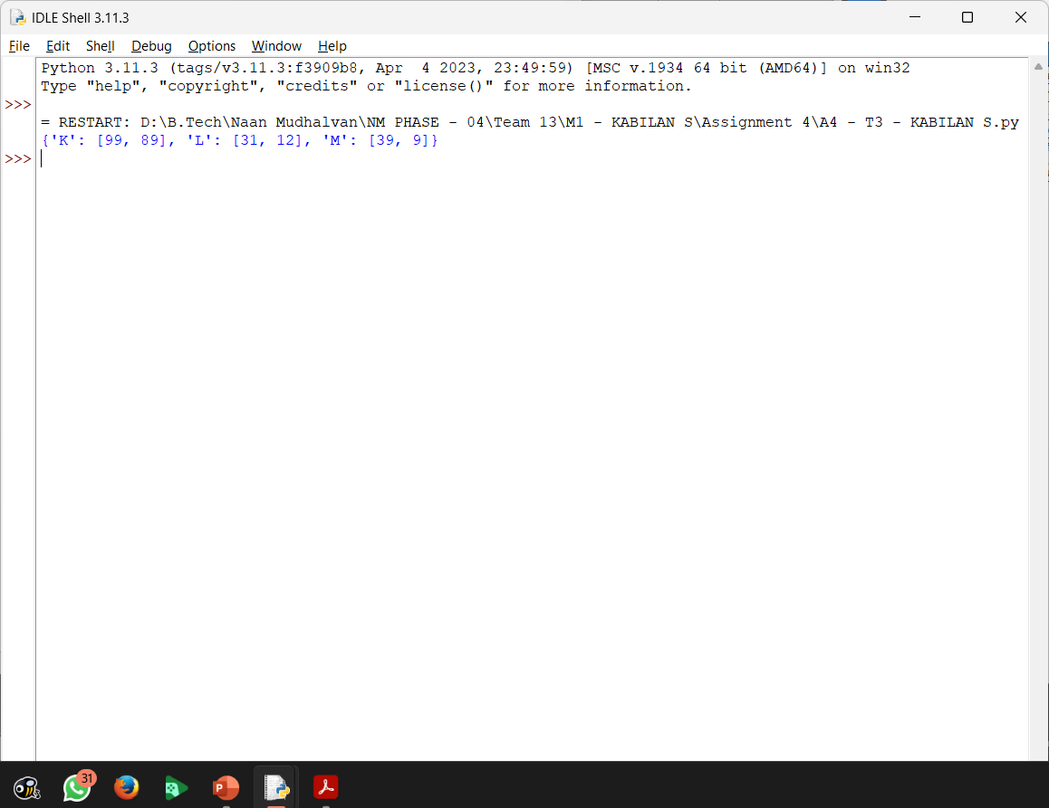
Task – 3 | Create a Dictionary with 3 keys and 2 values for each key.
Coding:
k = {'K':[99, 89],'L':[31, 12],'M':[39, 9]} print(k)
Output:

Slide 4
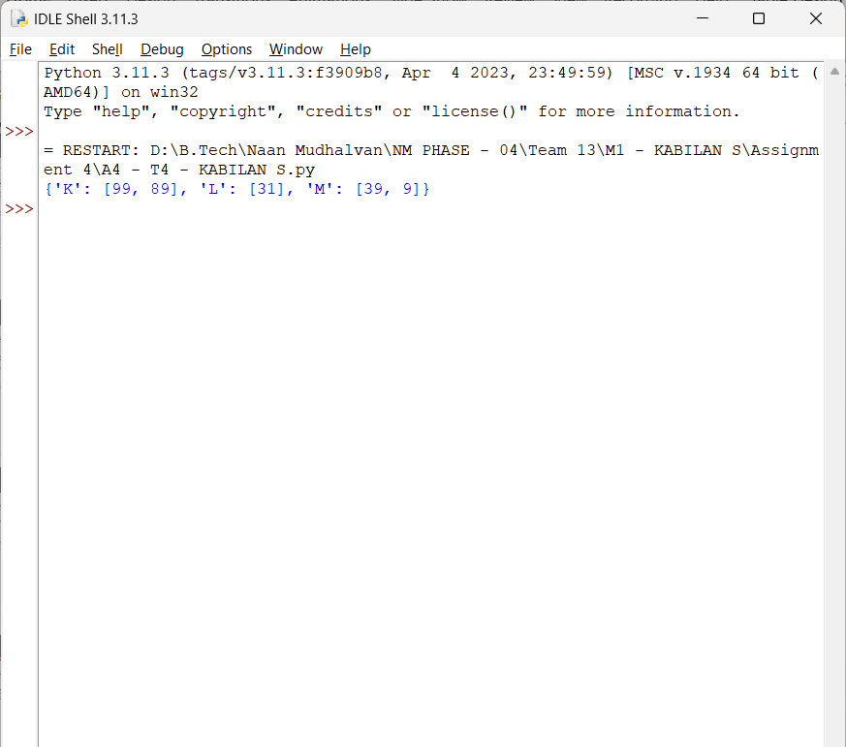
Task – 4 | Create a function with if statement which is used to find the odd numbers.
Coding:
def odd_elements(dictionary): return {key: [x for x in value if x % 2 != 0] for key, value in dictionary.items()} dictionary = {'K':[99, 89],'L':[31, 12],'M':[39, 9]} filter_dict = odd_elements(dictionary) print(filter_dict)
Output:

Slide 5
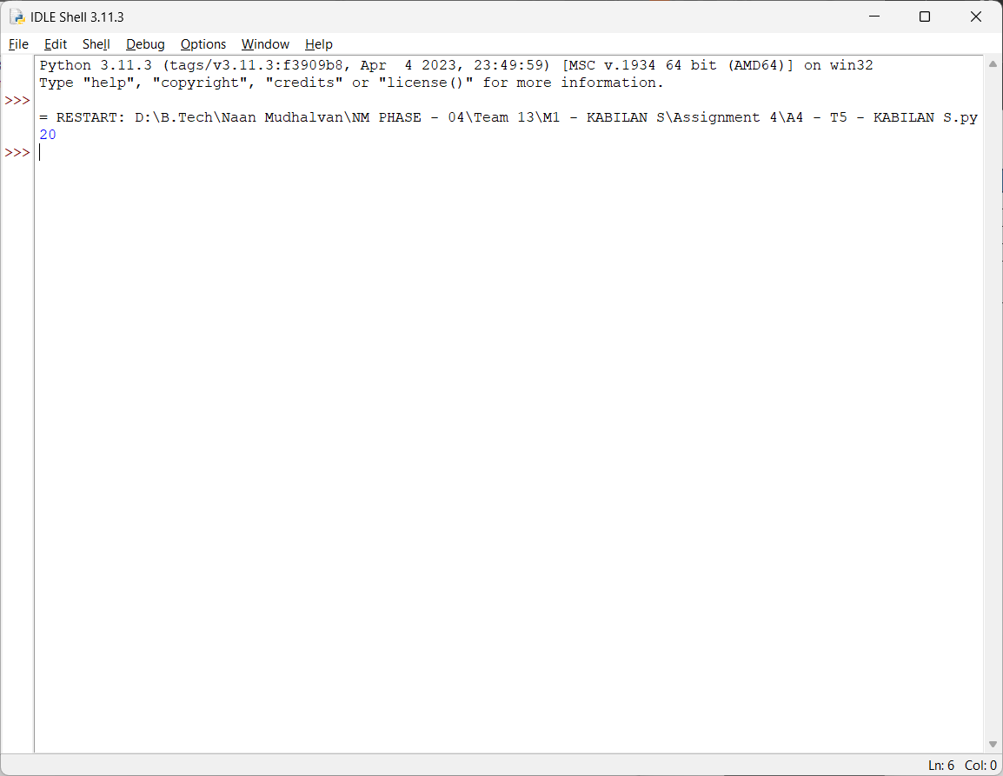
Task – 5 | Write a Python function to sum all the numbers in a list. Sample List : (8,2,3,0,7) Expected Output : 20
Coding:
list = [8,2,3,0,7] print(sum(list))
Output:

